Slide 1

Game-Theoretic Formulation for Security as a Service in UAV Swarms
Presented by: Gaurang Bansal

Slide 2
Overview
Objective
Literature Review and Research Gaps
Utility Functions of Entities
PSO and Optimal Price Strategy (Stackelberg Game)
Results & Discussion
Contributions of Work

Slide 3
System Model

Slide 4
Objective
UAVs are lightweight service providers
UAV’s provide user better access to Cloud Services
Network entities are heterogeneous and can belong to different stakeholders
Solution to optimize the profit gains of each participating entities

Slide 5
Current Literature Work
Static Pricing Model (Fixed)
Dynamic Pricing Model (Auctioning & Priority)
Machine Learning (Deep Learning Model): Reinforcement Learning

Slide 6
Research Gaps
No optimal strategy decisioning
Selfless entity optimization (homogenous entities)
No hierarchical model considered

Slide 7
Revisiting system model

Slide 8
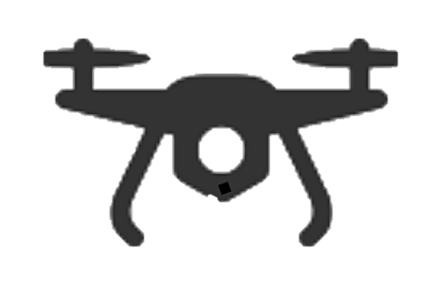

Utility of UAV
Behavioural Utility [Prospect Theory]
Price paid to cluster head per unit
Utility of UAV
amount of self-defense goods
‘self- defense’ implies the efforts by a cluster head to secure their system through technical solutions such as anti-virus and anti-spam software, firewalls, using secure operating systems, etc.
Propotional constant

Slide 9

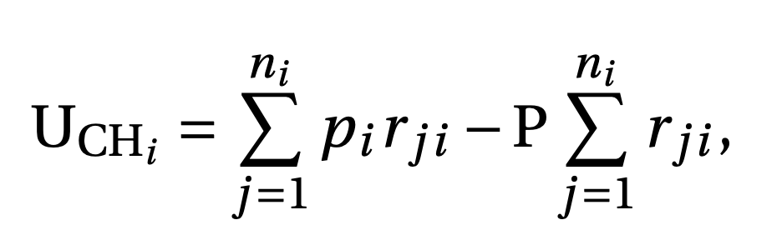
Utility of CH
Total requirement
Requirement
of UAV
Utility of CH
Price paid to BS per unit
Charge by CH

Slide 10
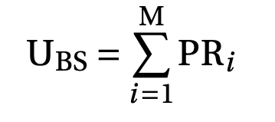
Utility of BS
Total requirement
Price set by BS
Utility of BS
Notes:
Ri

Slide 11

Constraint
Any stakeholder must get a minimum profit to deploy its UAV. As UAVs belong to different stakeholders, UAVs have different threshold values

Slide 12




Optimizing Utility

Slide 13
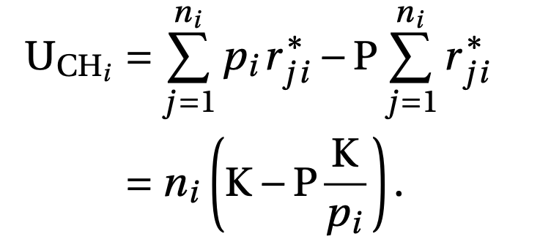
Utility of CH

Slide 14
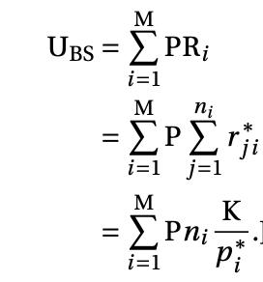
Utility of BS

Slide 15
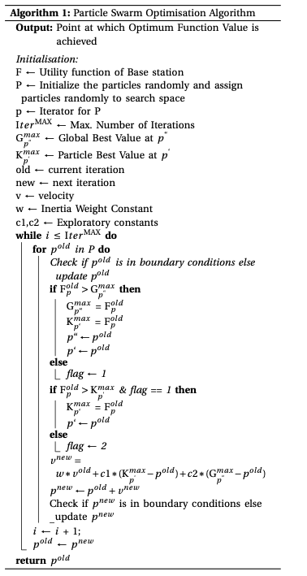
Particle Swarm Optimization

Slide 17
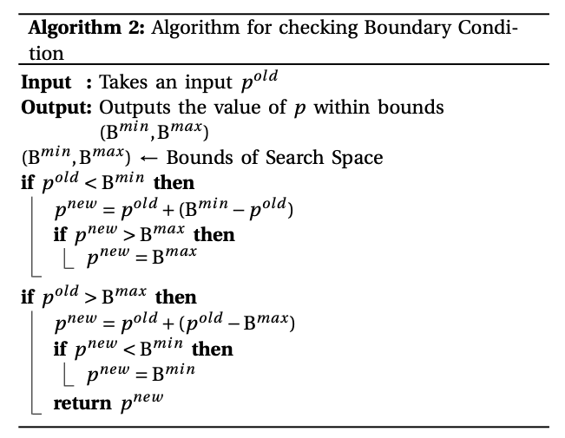

Slide 21
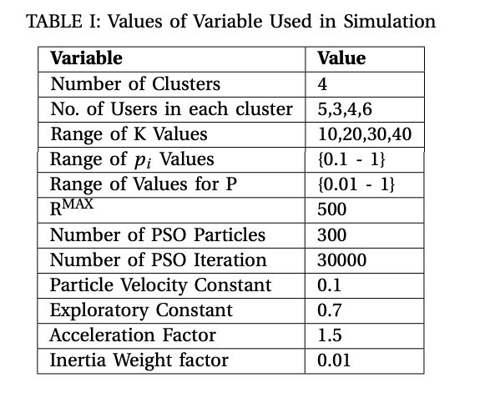
Simulation Values

Slide 22
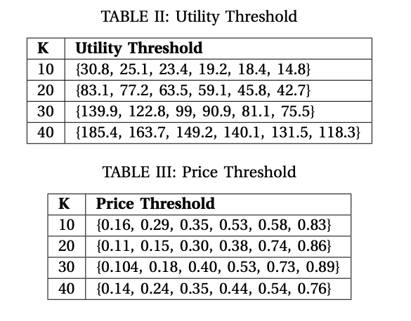

Slide 23
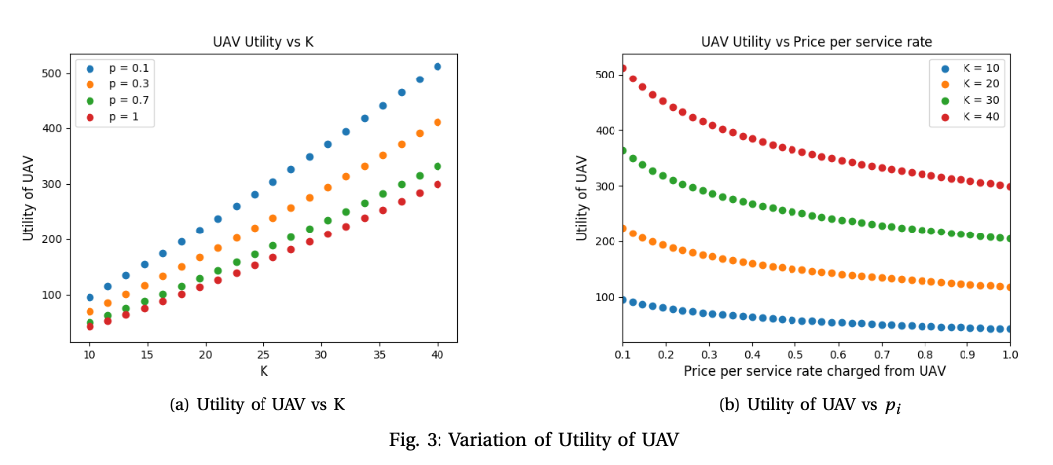
Variation of Utility of K
Results

Slide 24
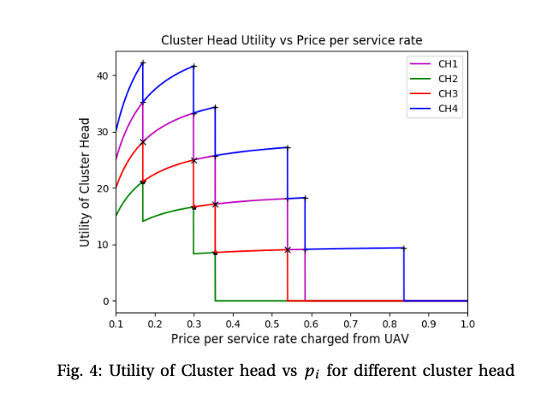
Results

Slide 25
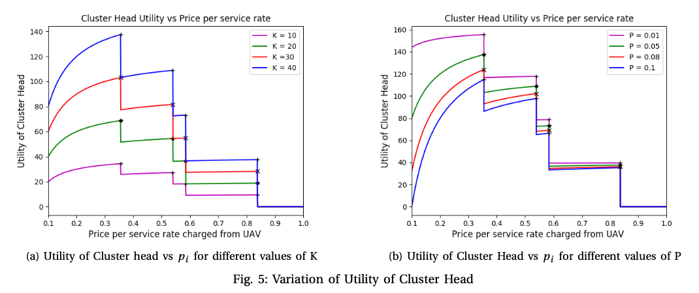
Utility of CH
Results

Slide 26
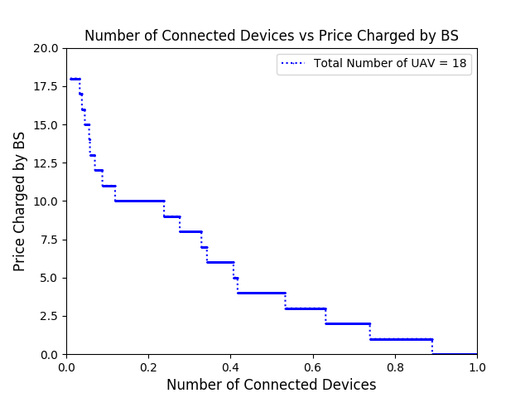
Utility of BS
Results

Slide 27
Utility of BS
Results

Slide 28
Highlights/Contributions of Work
Propose a Stackelberg game among entities using their utility and price functions to efficiently maximize profit gains
Utility vs Price strategy for UAV’s provide Security as a service (SaaS) as an alternative to cloud-based services. [Based on Prospect Theory]
Network entities are heterogeneous and can belong to different stakeholders
Using particle swarm optimization on utility functions of each entity, we create optimal price strategy for each entity to maximize its profit.
This study also shows the variation of different parameters on network scenario.

Slide 29
Thank You

